Slide 1

Project Proposal
Proposed
Intelligent Agent
Projects
Designing Intelligent Agents
Team
Members
Date
Team 1
5 Members
March 2026

Slide 2
Project Overview
Our Two Proposed Projects
1
Multi-Modal Adaptive Data Preprocessing Agent
2
Autonomous Garbage Detection & Collection Robot
An autonomous intelligent agent that learns and adapts optimal data preprocessing strategies across multiple data modalities.
A smart robotics solution for automated waste detection, navigation, and collection in urban environments.
Adaptive: Self-learning decision system
Perception: Computer vision & sensors
Multi-Modal: Tabular, image, audio support
Action: Autonomous navigation & collection
Goal: Demonstrate intelligent agent design with strong architectural reasoning and real-world applicability

Slide 3
Project 1 Foundation
Why Preprocessing Is Critical in AI
Current Human Expert Approach
Critical Pipeline Phase
Preprocessing is one of the most important phases in any AI pipeline, directly determining the quality of input data for model training.
1
Data Characteristics
Experts analyze dataset properties, distributions, and quality metrics
2
Task Requirements
Consider the specific machine learning task and model requirements
3
Experience
Performance Dependency
Leverage domain knowledge and past experimentation results
Model performance heavily depends on data quality. Even the most sophisticated algorithms cannot compensate for poorly preprocessed data.
The Consequence
Poor preprocessing → poor accuracy. Inadequate data preparation leads to biased models, overfitting, and unreliable predictions.
The Key Question
"What if an agent could take these decisions autonomously?"

Slide 4
Project 1 Details
Multi-Modal Adaptive Data Preprocessing Agent
What does "Adaptive" mean?
What does "Multi-Modal" mean?
Autonomous Decision-Making
We support diverse data types through unified intelligent processing:
Agent decides preprocessing strategies based on dataset characteristics without human intervention
Tabular / Sensor Data
Structured datasets, time-series, IoT sensor readings
Self-Evaluation
Continuously evaluates its decisions against performance metrics to ensure optimal outcomes
Image Classification
Computer vision datasets, medical imaging, object recognition
Experience Learning
Learns from past preprocessing attempts and their outcomes
Audio Classification
Continuous Improvement
Speech recognition, sound classification, music analysis
Improves over time through meta-learning, becoming more efficient with each dataset

Slide 5
Project 1 Architecture
Agent Perspective: Inputs and Outputs
Sensors
(Inputs)
Actions
(Actuators)
Performance
Measure
Dataset Statistics
Apply Preprocessing
Accuracy
Size, dimensions, feature types, distributions
Normalization, encoding, augmentation, cleaning
Overall prediction correctness
Missing Values
Train Lightweight Model
F1-Score
Percentage, patterns, impact assessment
Quick evaluation of preprocessing effectiveness
Balanced precision and recall
Class Imbalance
Compare Pipelines
Robustness
Distribution ratios, minority class detection
Benchmark multiple strategies side-by-side
Consistency across data variations
Quality Metrics
Store Experience
Processing Time
Image/audio resolution, noise levels, artifacts
Save successful strategies for future datasets
Efficiency of preprocessing pipeline
Validation Accuracy
Update Knowledge Base
Resource Usage
Performance feedback from test pipelines
Meta-learning from accumulated experiences
Memory and computational efficiency
This makes it a rational learning agent — perceiving environment, taking actions, and optimizing performance

Slide 6
Project 1 Design
Proposed Architecture
Layer 1
Layer 2
Layer 3
Perception Layer
Strategy Evaluation
Learning Layer
Dataset profiling and feature extraction
Pipeline testing and comparison
Knowledge storage and meta-learning
Analyzes data characteristics, quality metrics, and statistical properties
Tests multiple preprocessing strategies and benchmarks performance
Stores successful strategies and learns patterns for future datasets
Perception
Deliberation
Learning
Comprehensive dataset profiling including statistical analysis, quality assessment, and feature characterization
Systematic testing and comparison of multiple preprocessing pipelines with performance benchmarking
Accumulates knowledge from past experiences and applies meta-learning for continuous improvement
Hybrid layered architecture combining deliberation and learning for intelligent decision-making

Slide 7
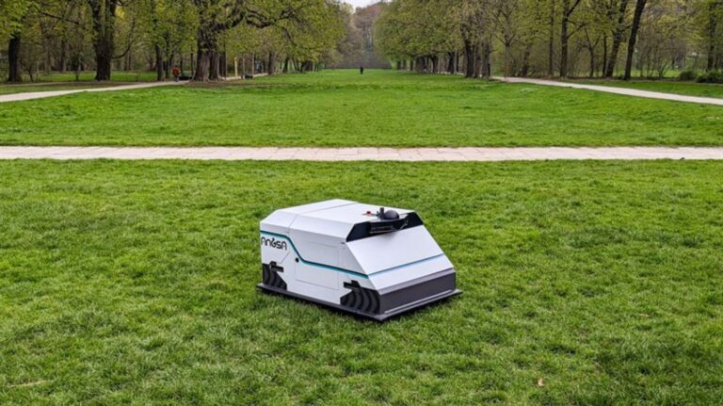
Project 2 Foundation
Motivation — Smart Autonomous Waste Collection
Inefficiency of Manual Collection
Manual waste collection is labor-intensive, time-consuming, and costly. Traditional methods cannot scale efficiently with growing urban populations and waste generation rates.
Smart City Requirements
Modern smart cities require automation and intelligent systems to manage urban infrastructure efficiently. Waste management is a critical component of sustainable city operations.
Project Vision
Robotics + AI Integration
"We design a robot agent that perceives, decides, and acts."
The convergence of robotics and artificial intelligence enables autonomous systems that can perceive, decide, and act in complex real-world environments.
Perceive
Decide
Visually Impactful & Practical
Environment sensing
Intelligent planning
This project is both demonstrable and practical, offering clear visual feedback and real-world applicability that makes it ideal for academic presentation.
Act
Physical execution

Slide 8
Project 2 Architecture
Agent View: Inputs and Actions
Sensors
Actions
Performance
Camera
Move / Navigate
Trash Collected
Object detection and classification for identifying waste items
Autonomous movement towards targets and waypoints
Total waste items successfully collected per mission
Avoid Obstacles
Energy Efficiency
Distance Sensors
Real-time collision avoidance and path replanning
Battery consumption per collection task
Ultrasonic and infrared for obstacle detection and navigation
Pick or Push Trash
Time Efficiency
Battery Level
Mechanical manipulation for waste collection
Average time to complete collection missions
Real-time power monitoring for energy management
Return to Base
No Collisions
Map Information
Autonomous return for charging or emptying
Safety metric: zero collision incidents
SLAM-based environment mapping and localization
This is a sequential, partially observable environment — the agent must make decisions with incomplete information while considering future states

Slide 9
Project 2 Design
Proposed Architecture
Layer 1
Layer 2
Layer 3
Reactive Layer
Tactical Layer
Deliberative Layer
Obstacle avoidance & emergency response
Target selection & local planning
Route optimization & mission planning
Fast, instinctive responses for safety-critical situations
Decides which trash to collect next based on proximity and priority
Global path planning considering battery, time, and coverage
Needs Fast Reaction
Needs Planning
Reactive layer provides immediate response to dynamic obstacles and safety hazards without deliberation delay
Deliberative layer enables strategic decision-making for optimal coverage and resource management
Hybrid architecture combining reactive responses with deliberative planning — essential for real-world robotics

Slide 10
Comparative Analysis
Agent Analysis Summary
Property | Preprocessing Agent | Garbage Robot
Observable | Partially | Partially
Deterministic | Stochastic | Stochastic
Sequential | Yes | Yes
Dynamic | Static | Dynamic
Architecture | Deliberative + Learning | Reactive + Deliberative
Preprocessing Agent Insights
Garbage Robot Insights
Operates in a static environment where the dataset doesn't change during processing. Uses deliberative planning combined with meta-learning to improve over time. The partially observable nature comes from not knowing the optimal preprocessing strategy a priori.
Operates in a dynamic environment where obstacles, trash locations, and battery levels change continuously. Requires reactive responses for safety combined with deliberative planning for efficiency. The partially observable nature comes from limited sensor range and unknown future states.

Slide 11
Conclusion
Why These Projects Fit the Course
Clearly Intelligent Agents
Scalable and Extensible
Both projects embody the core principles of intelligent agents: perception, decision-making, action, and learning. They demonstrate autonomous operation in complex environments with clear performance metrics.
The architectures are designed for future growth and enhancement. The preprocessing agent can support additional data modalities, while the robot can integrate new sensors, manipulation capabilities, and coordination with other agents.
Strong Architectural Reasoning
Technically Feasible
Each project features well-designed hybrid architectures combining multiple AI paradigms: deliberative + learning for preprocessing, reactive + deliberative for robotics. This demonstrates deep understanding of agent design principles.
Both projects leverage established technologies and frameworks: Python ML libraries, ROS for robotics, computer vision models, and simulation environments. They are achievable within course timelines while remaining academically rigorous.
Real-World Impact
Both projects address practical, high-impact problems: automated data preprocessing accelerates AI development, while autonomous waste collection contributes to smart city infrastructure and environmental sustainability.

